Slide 1

Power BI enabled Crop Production Analysis
Student Name : Athiyaman M
AICTE ID : STU63a5c8593b4db1671809113
College : IFET College of Engineering

Slide 2

PROBLEM STATEMENT
Traditional methods of analyzing crop production data are inefficient and lack real-time insights.
Suboptimal decision-making in agriculture leads to reduced productivity and potential losses.
There is a need for a solution that offers intuitive and real-time analysis of crop production data.

Slide 3
Project Description
Develop a data analytics platform using Power BI.
Integrate weather data, soil quality, crop yield, market trends, and historical data.
Provide interactive dashboards, predictive analytics, and customizable reporting.
Empower users to make informed decisions regarding crop planning and resource allocation.
Revolutionize crop production analysis for improved productivity and sustainability.

Slide 4

WHO ARE THE END USERS?
Farmers: Optimize crop production strategies.
Agricultural Consultants: Provide advisory services.
Agricultural Enterprises: Optimize supply chain management.
Government Agencies: Monitor and regulate agricultural activities.

Slide 5

Technology Used
Power BI
ChatGPT

Slide 6
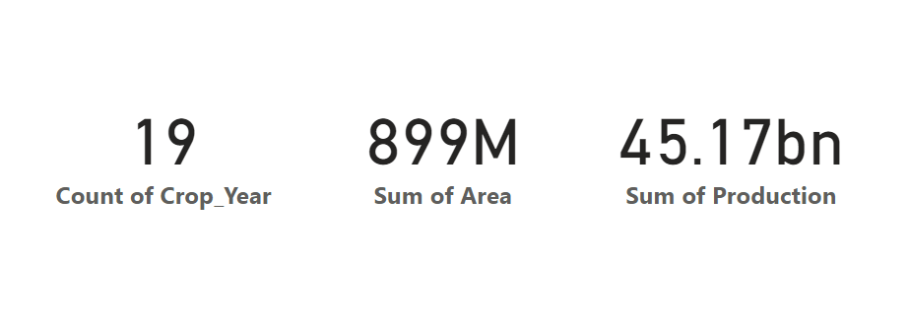
RESULTS
Sum of total Crops, Area and Productions.
Demo Link

Slide 7
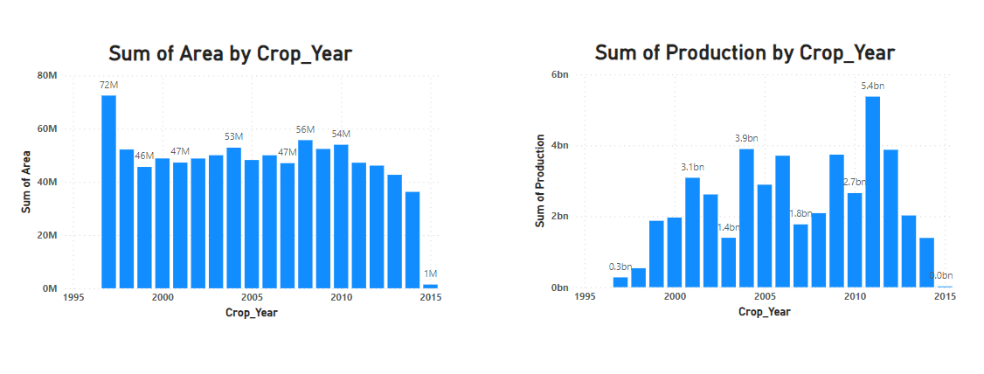
RESULTS
Sum of crop year by Area and Production.
Demo Link

Slide 8
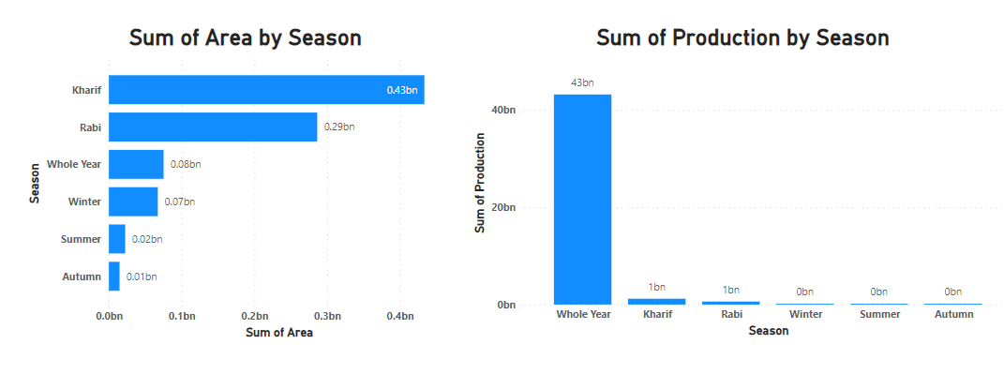
RESULTS
Sum of Area and Production by season.
Demo Link

Slide 9
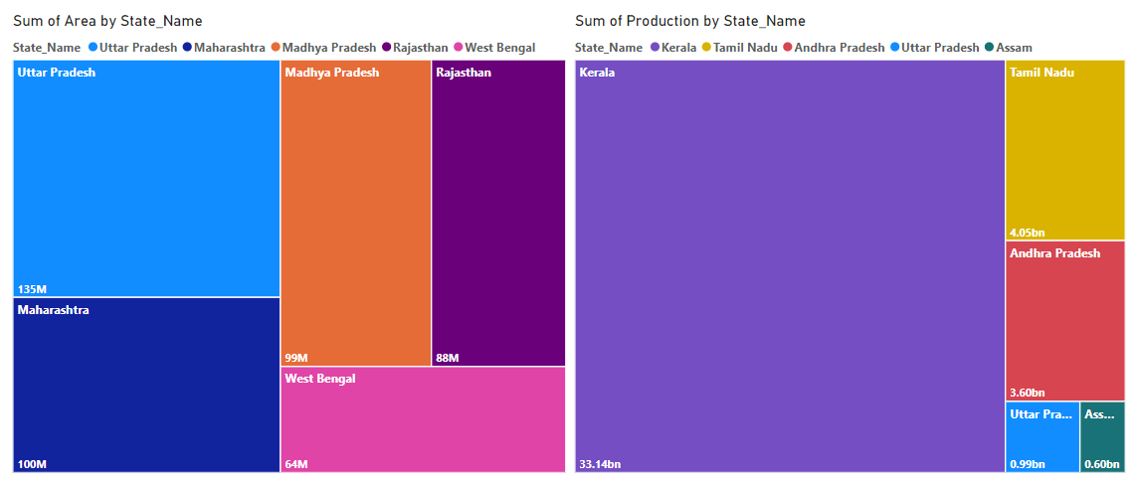
RESULTS
Sum of Area and Production by state.
Demo Link

Slide 10
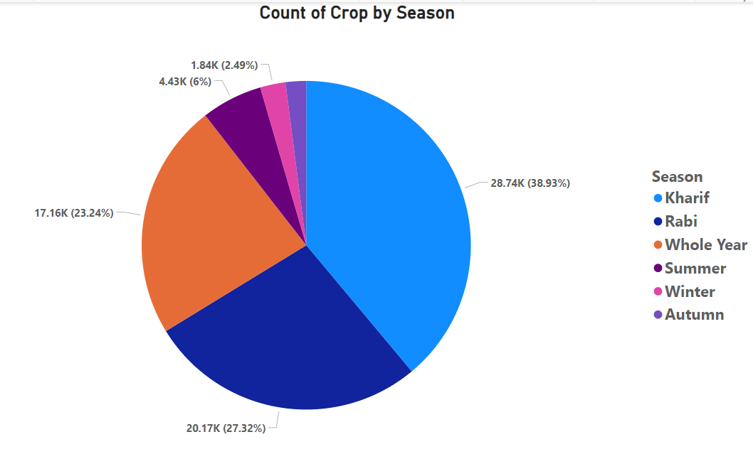
RESULTS
Demo Link

Slide 11
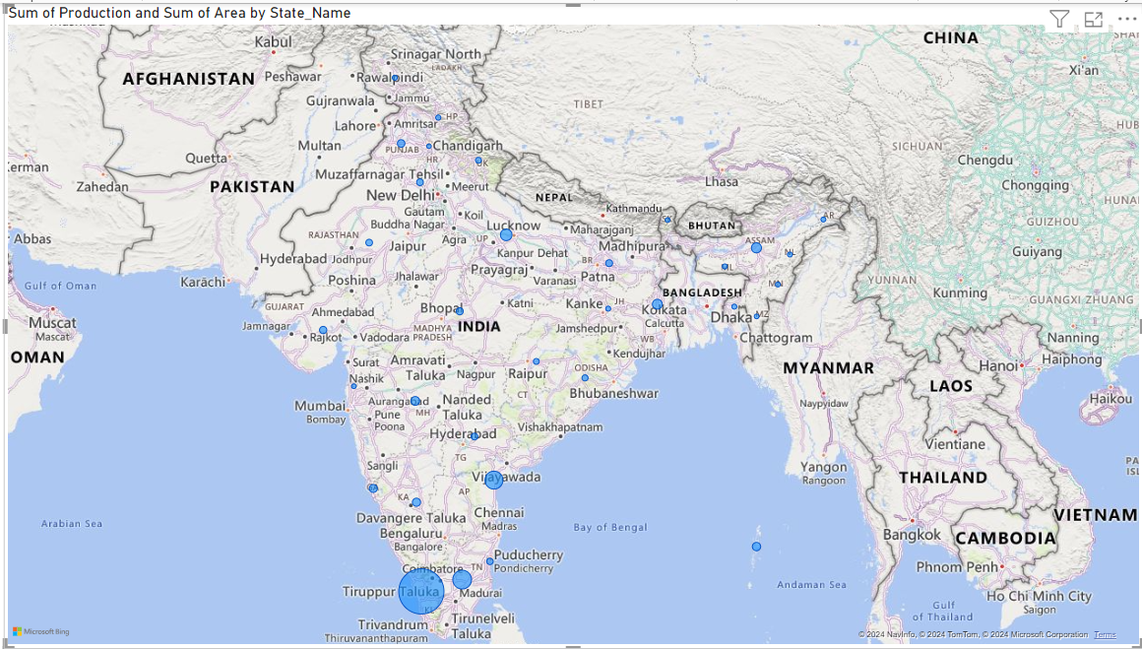
RESULTS
Demo Link

Slide 12
Thank you
.
.

